Slide 1

Car renter application
Made by Dávid Balogh ,Valentin Szilveszter Füredel, Levente Tarnóczi

Slide 2
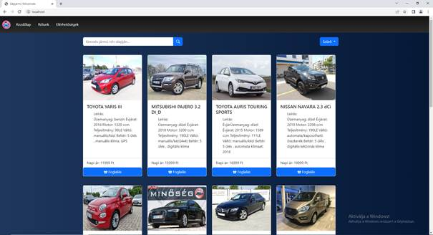
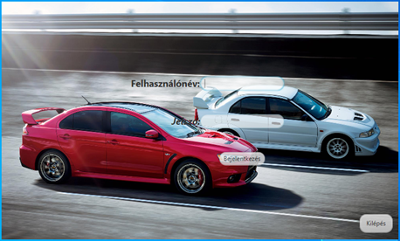
Information about the application
Notes:
((DÁVID))
In our project theme is car renting. We have a web application and java application.
The web application made for the users who want to rent a car . You can handle your own profile.
The java applicaion made for the company workers because they manage the cars and the rents.

Slide 3




Programming languages
Notes:
((DÁVID))
We used this program language .`’{/[(„ITT SOROD FEL ŐKET” )]/}’`

Slide 4



System requirements
Minimal system requirements:
Operation System: Windows 10/Linux/MacOS
Processor: 1 GHz or more
RAM: 1 GB
Storage size: 1 GB
GPU: DirectX 9 version or newer
Screen size: 800x600
Optimal system requirements:
Operation System: Windows 10/Linux/MacOS
Processor: 2 GHz or more
RAM: 2 GB
Storage size: 1 GB
GPU: DirectX 9 version or newer
Screen size: 1280x1024
Notes:
((DÁVID))
This is the system requirements, this is a default OS system requirements
This is the minimum(MUTASS RÁ)
And this is the optimal(MUTASS RÁ)

Slide 5






Programs we used:
Notes:
((SZILVI))
We used Trello for the project managing.
(NYOMD!)
We used github for version management.
(NYOMD!)
The XAMPP helped for database starting.
(NYOMD!)
We used Visual Studio Code for codeing the web page.
(NYOMD!)
Intellij hepled for coding the java application.
(NYOMD!)
We used Micorsoft Office Word for write the software documentation.

Slide 6
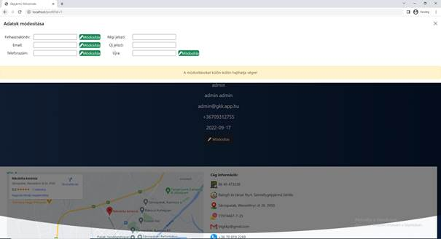
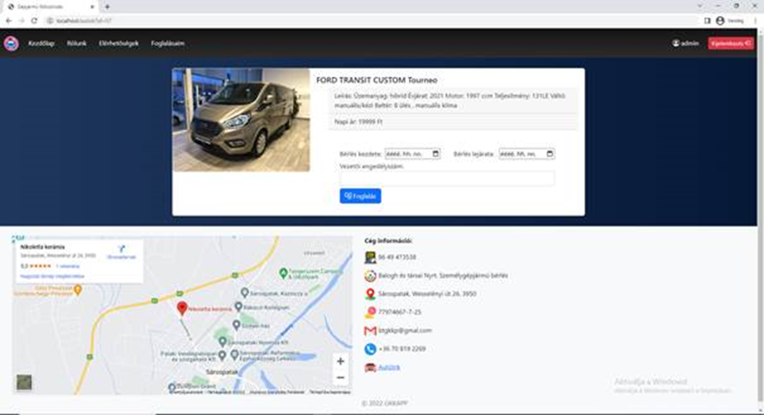
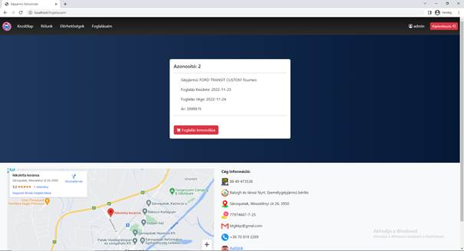
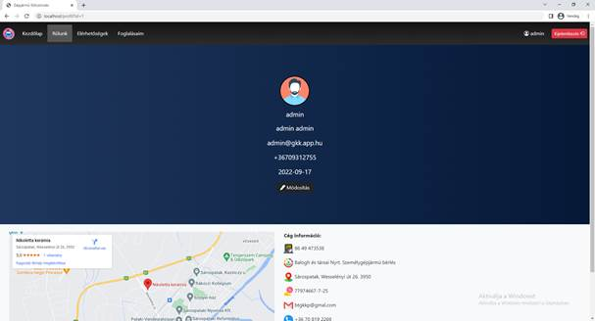
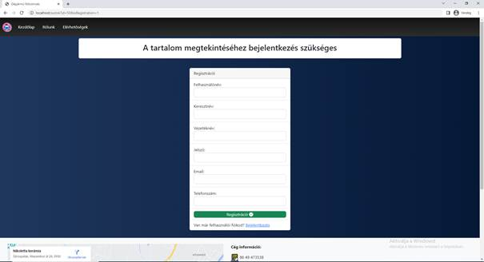
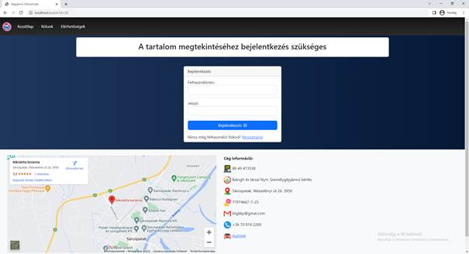
The web application
Notes:
((SZILVI))
In the web application you can login(NYOMD!) and register(NYOMD!) .After registration you can choose a car (NYOMD!)on this page. After that you (NYOMD!)can rent a car . (NYOMD!)In the „Foglalásaim” page it shows your rents and you can resign it. If you click there (mutass jobb felülre a kijelentkezés mellé) (NYOMD!) it will forward you to your profil page where you can (NYOMD!)modify your account.

Slide 7
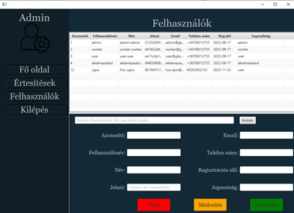
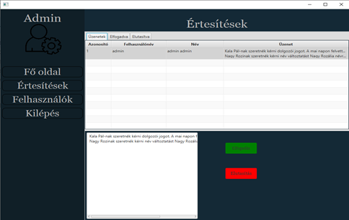
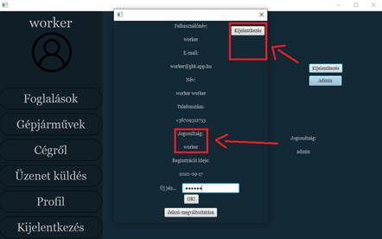
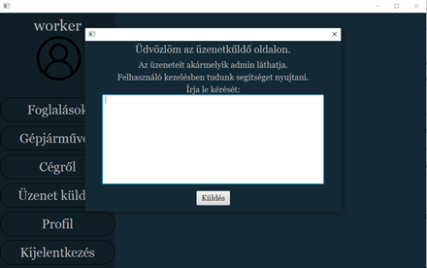
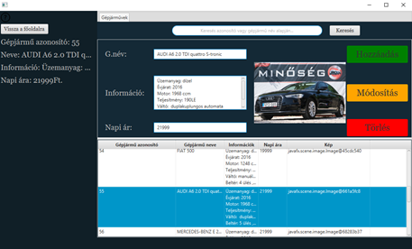
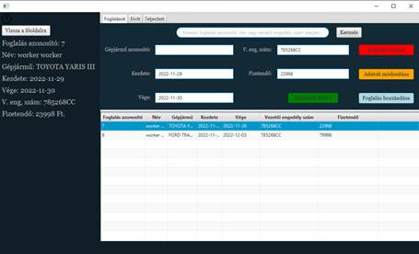
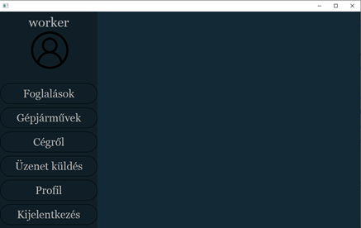
Java application
Notes:
((LEVI))
In the java application the worker can handle the rents(NYOMD!) like delete it and modifing it or add new rents. (NYOMD!)And you can add,modify and delete cars on „Gépjárművek” page . (NYOMD!)The worker can send message for the admin in the „Üzenet küldés” page if you have a problem. (NYOMD!)In the „Profil” page you can see your profile datas. If you an admin you have a admin button in „Profil” page and it shows the admin page where you (NYOMD!)can handle messages and(NYOMD!) users datas.

Slide 8
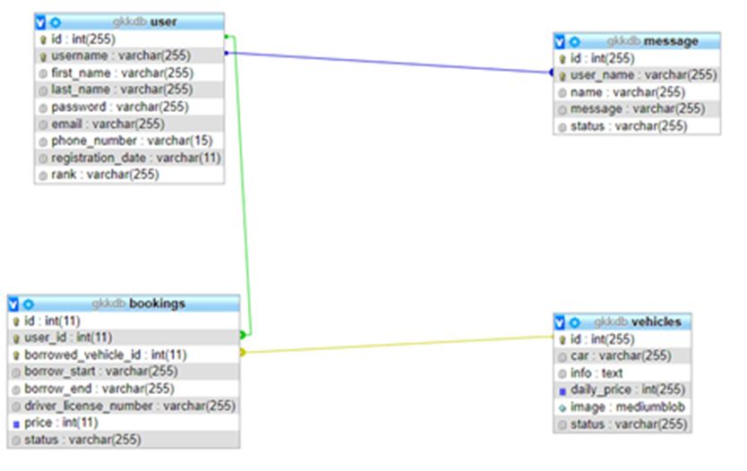
Database
Notes:
((LEVI))
We have 4 different tables. We have user table, in this table we store information about users. In the booking table we store informations about the bookings like when started the rent and driver license number or price. In the vehicles table we store data about cars. And in the message table we store data about sended messages.

Slide 9
Thank you for your attention!

